Slide 1
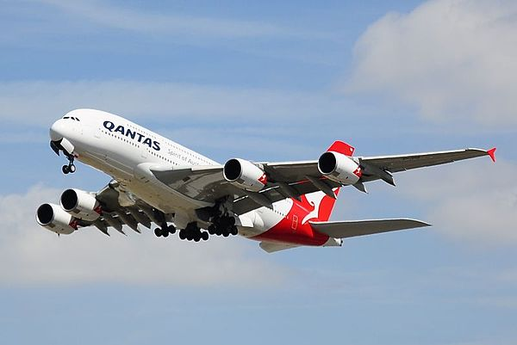
Flight Price Prediction
This Photo by Unknown Author is licensed under CC BY-SA

Slide 2
Problem Statement
Flight ticket prices can be something hard to guess and we know how unexpectedly they vary.
The cheapest available ticket on a given flight gets more and less expensive over time. This usually happens as an attempt to maximize revenue based on Time of purchase.
The last-minute purchases are expensive.
Especially when traveling shorter distances, the difference in cost for air travel and other modes of transport, would seem comically large.
Raising prices on a flight will reduce sales.

Slide 3
Conceptual Background of the Domain Problem
Airline Industry is one of the most sophisticated industries in its use of dynamic pricing strategies to maximize its revenue.
The model used by airline companies for the prediction of a ticket price is not public and it is really very complicated because it is based on proprietary algorithms and hidden variables.
There is a need to develop a model for the consumers from which they can predict these prices and moreover analyze which feature is the most influential in determining these prices.
In this project I have applied Machine learning algorithms on a dataset consisting of various factors which can influence the flight fares to prepare such a model.

Slide 4
Mathematical/ Analytical Modelling of the Problem
I have used web-scraping (selenium) for scraping the details of flights from Via.com for collecting the data.
I have collected different locations flight travels history and scarped the details like Air-lines name, Source, Destination, duration, arrival time, departure time, number of stops, Price and date of the flight.
So, by using all the data collected, we need to predict the flight prices.
Then I have put all the websites details together and created a data frame and saved in a excel file.

Slide 5
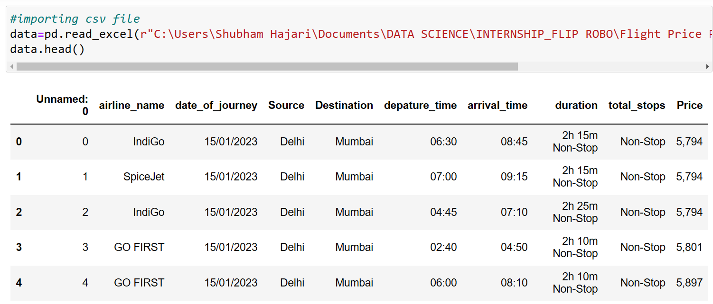
Data Sources and their formats
The dataset consists of 9 attributes with over 3435 entries. The features of the dataset are as follows:
1.airline_name: The name of the airlines
2.date_of_Journey: The date of the journey.
3.Source: Source city of the flight.
4.Destination: Destination city of the flight.
5.Depature_time: Time of the departure of flight.
6.Arrival_Time: Time of arrival of the flight.
7.Total_stops: No of stops
8.Duration: The total time a person sits in the flight.

Slide 6
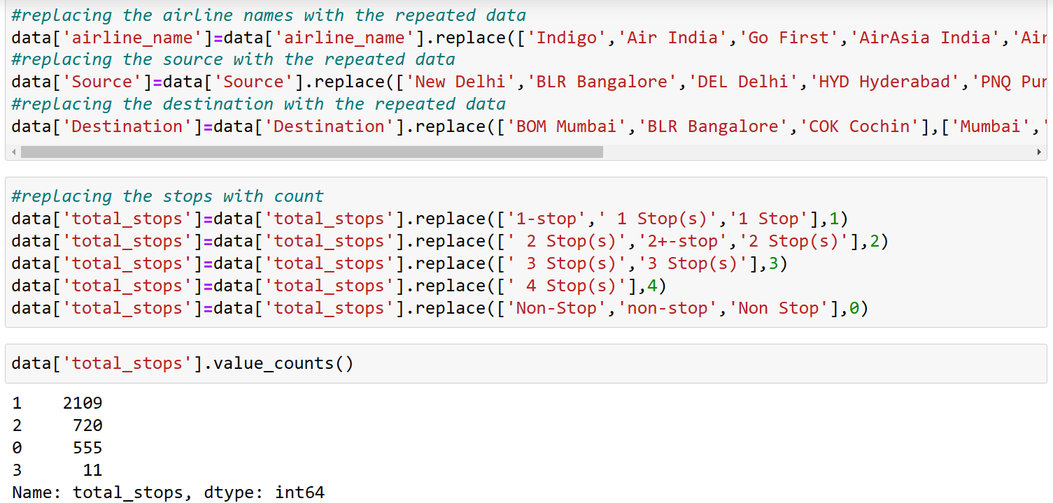
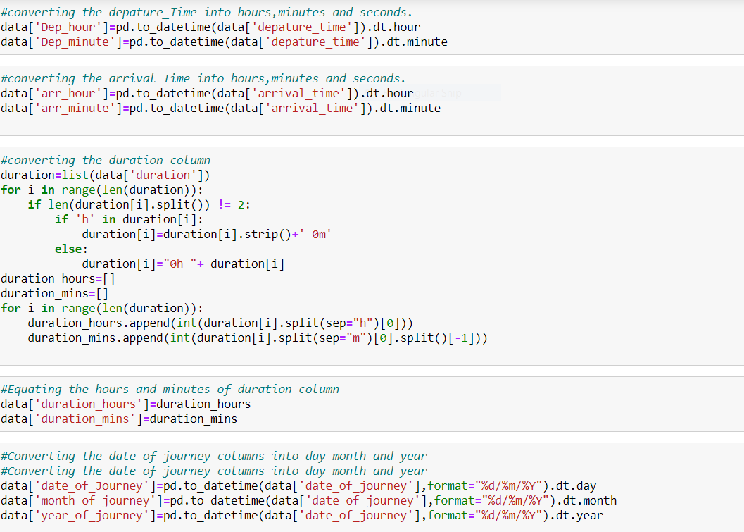
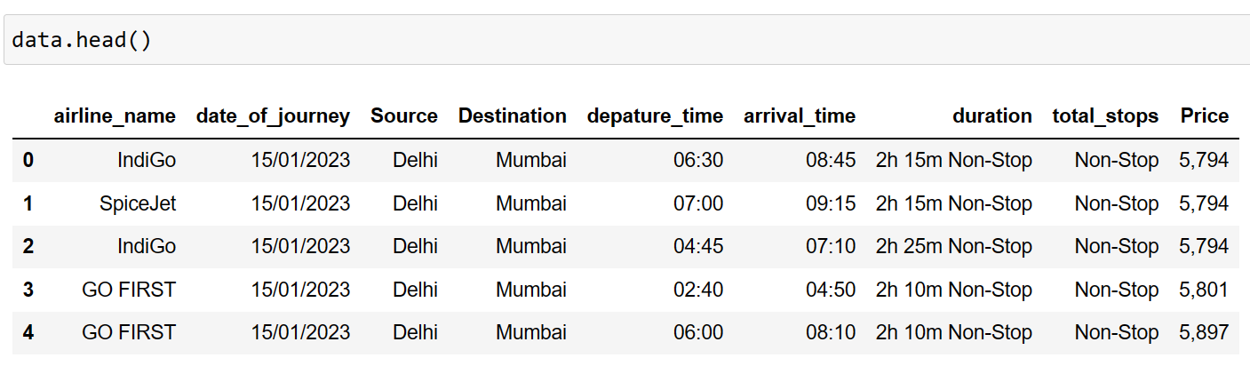
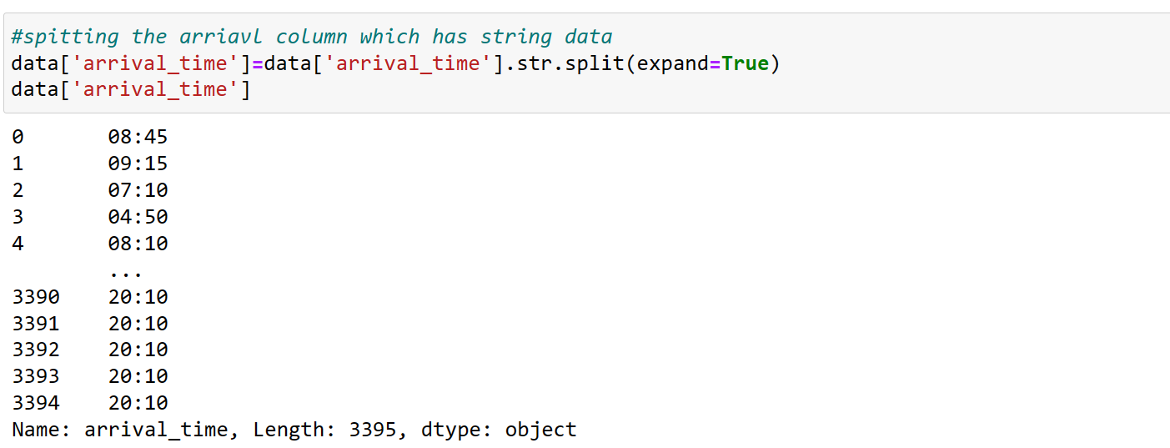
Data Pre-processing Done
There are no null values in the dataset. The arrival time column has some extra characters added in the time those are to be cleaned so I have used str.split() method to split the time and the unwanted data and cleaned the arrival time column and converted all the time and duration columns which are having special characters and letters using date time library in pandas as shown below.

Slide 7
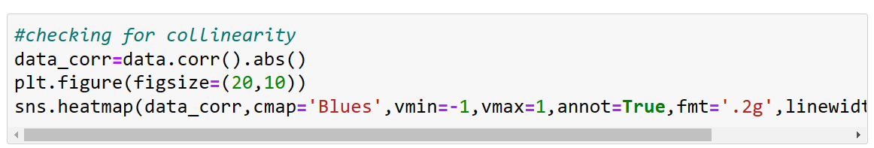
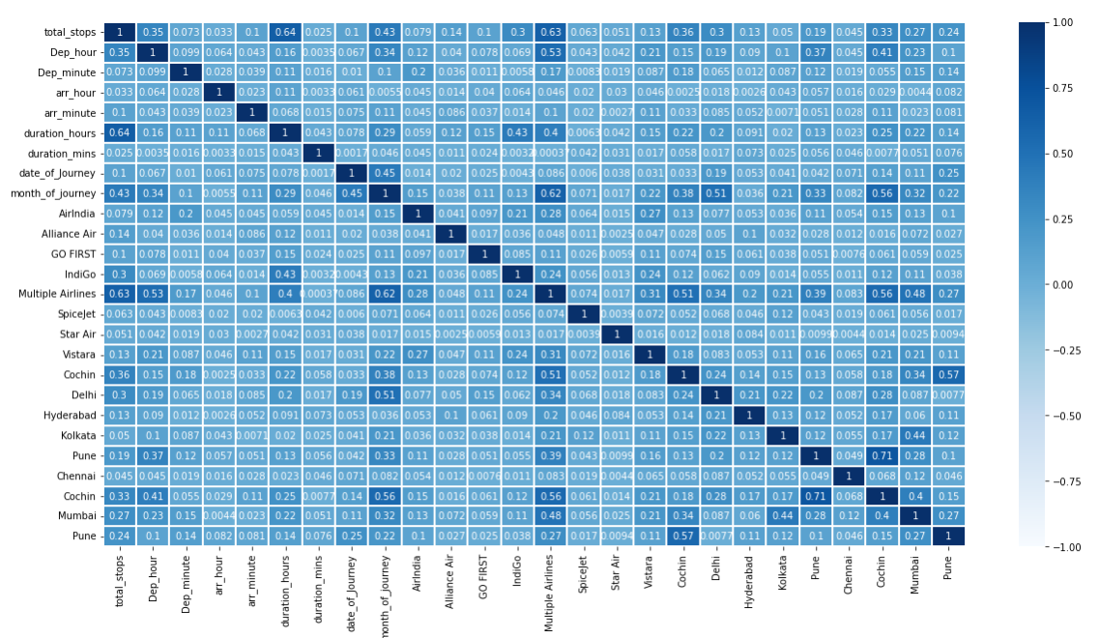
Data Inputs- Logic- Output Relationships
For checking the relation between the columns, I have used correlation matrix to find the relation and plotted heat map to visualise the percentage of the correlation. The below are the observations from the heatmap.
1.The Dark blue indicates high correlation and light blue indicates less correlation.
2. Even there are some columns which are highly correlated with each other which means there exists multi collinearity problem with Pune and cochin columns.

Slide 8
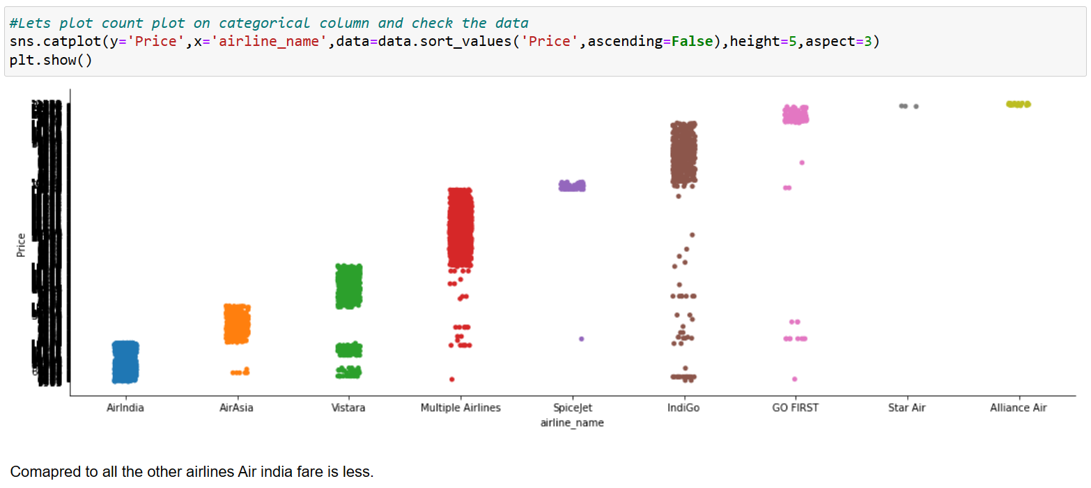
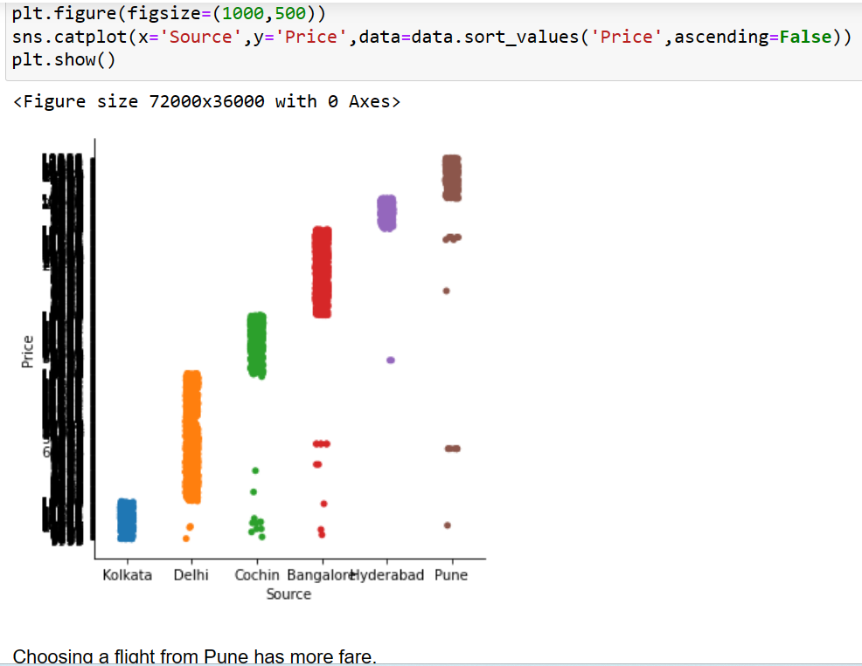
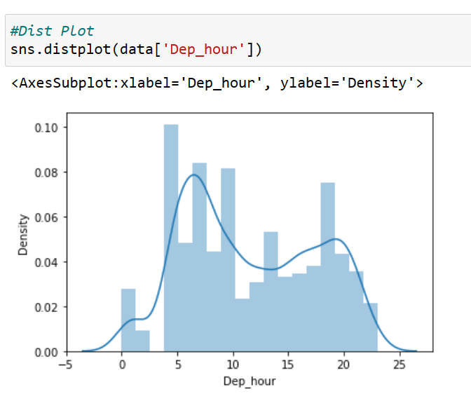
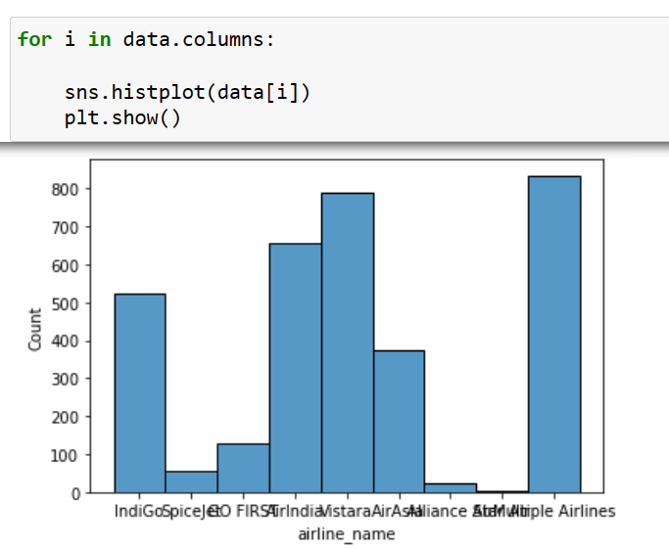
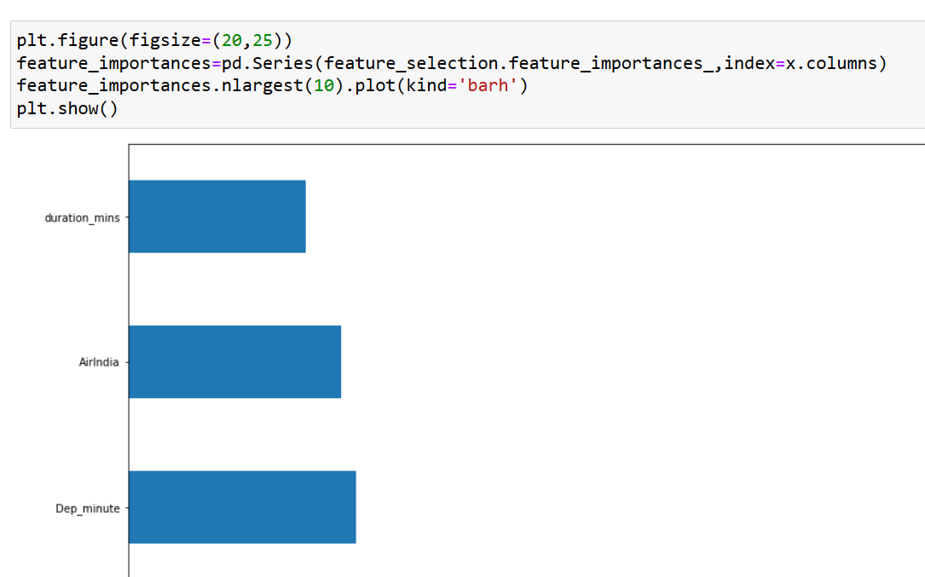
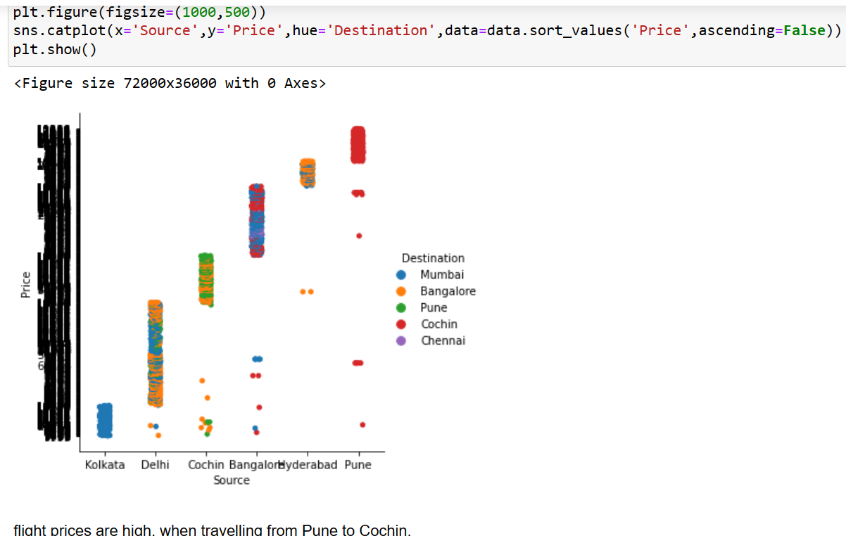
Visualizations

Slide 9
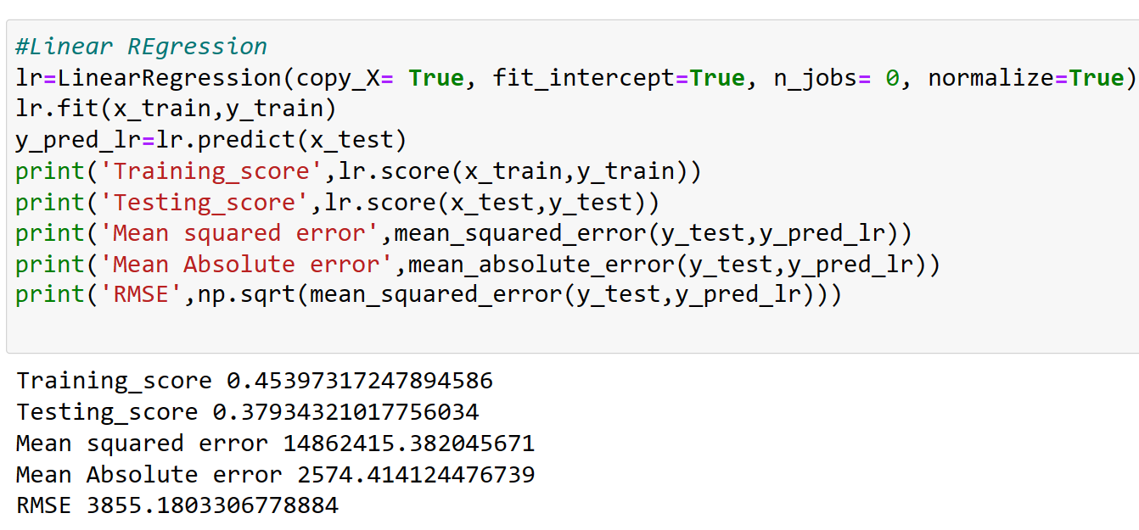
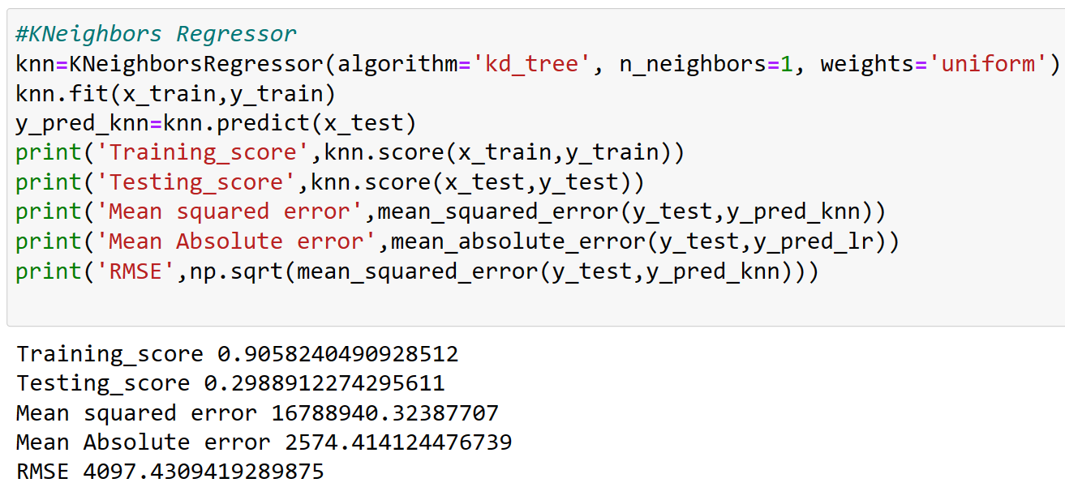
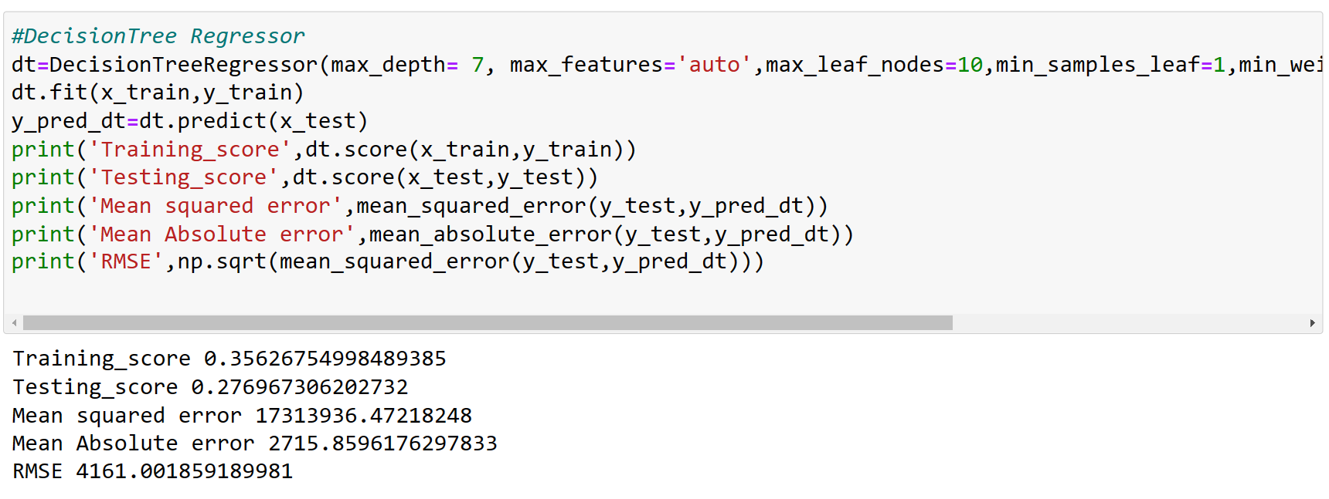
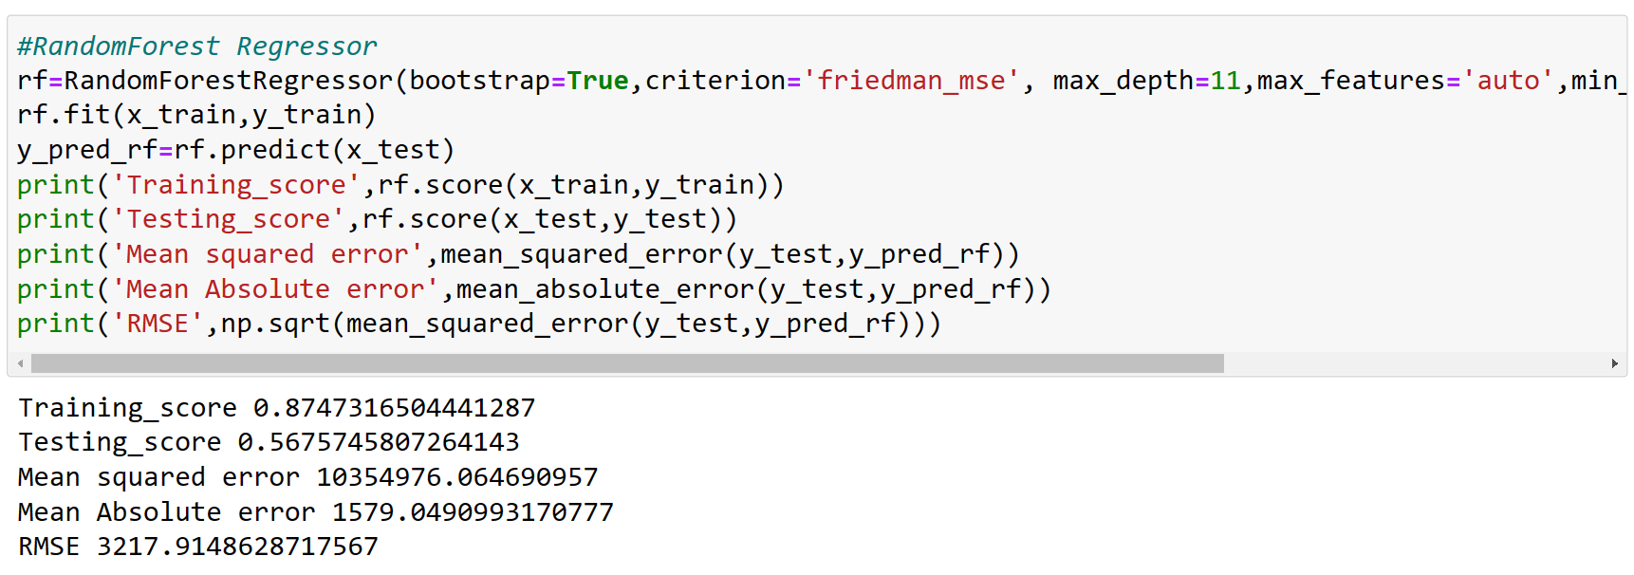
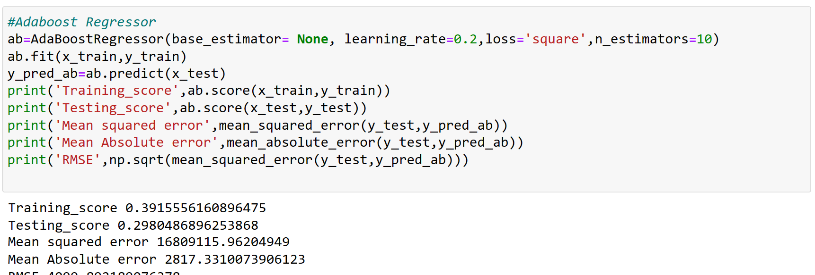
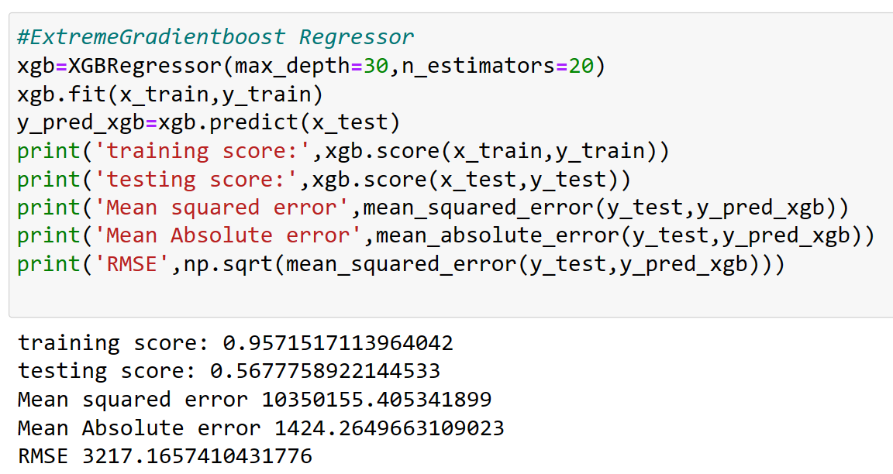
Run and Evaluate selected models

Slide 10
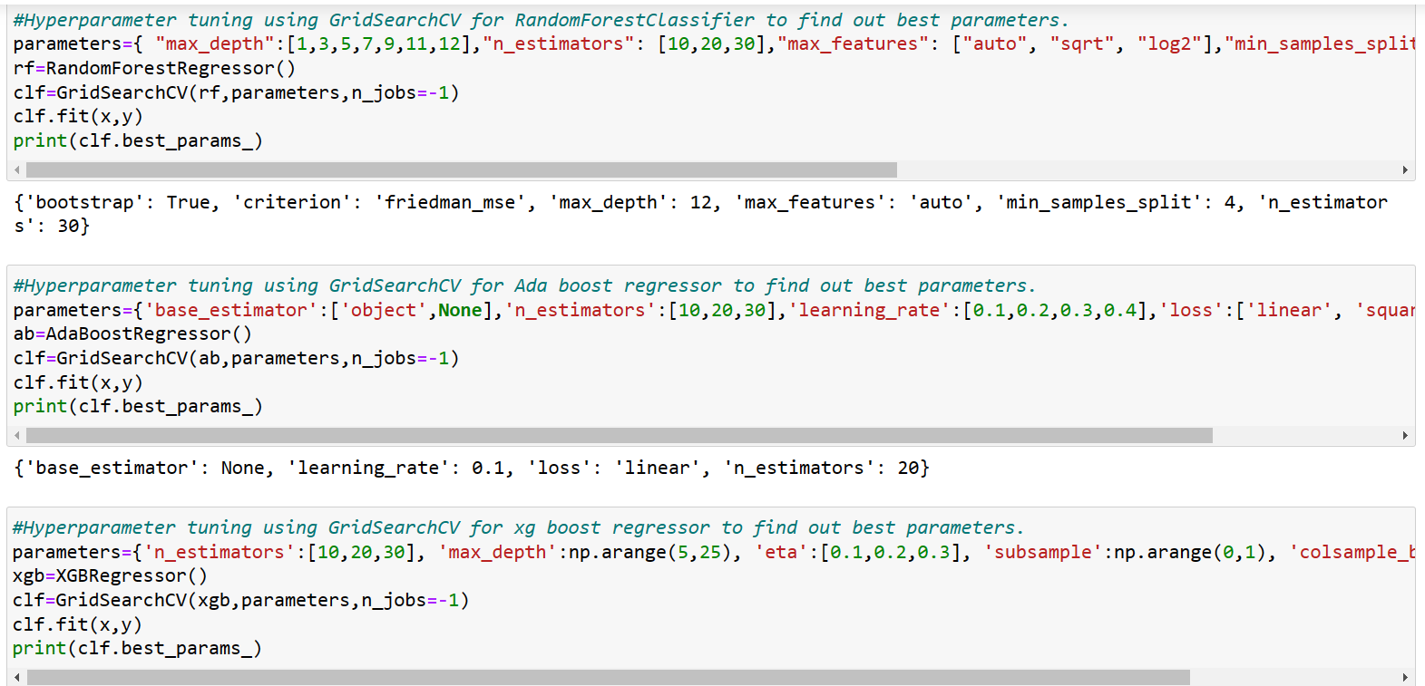
Key Metrics for success in solving problem under consideration

Slide 11
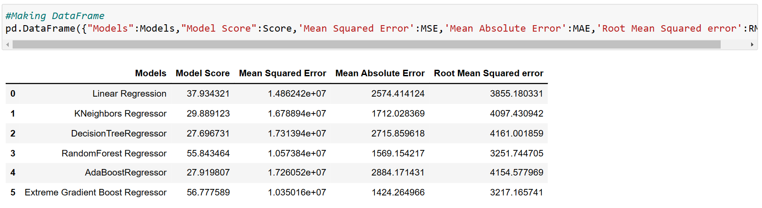
Interpretation of the Results

Slide 12
CONCLUSIONS
We got our best model as XGBoost Regressor with the r2 score of 56.7% and the RMSE value is also less compared to all other models. So, we can go further build our model using XGBoost Regressor.

Slide 13
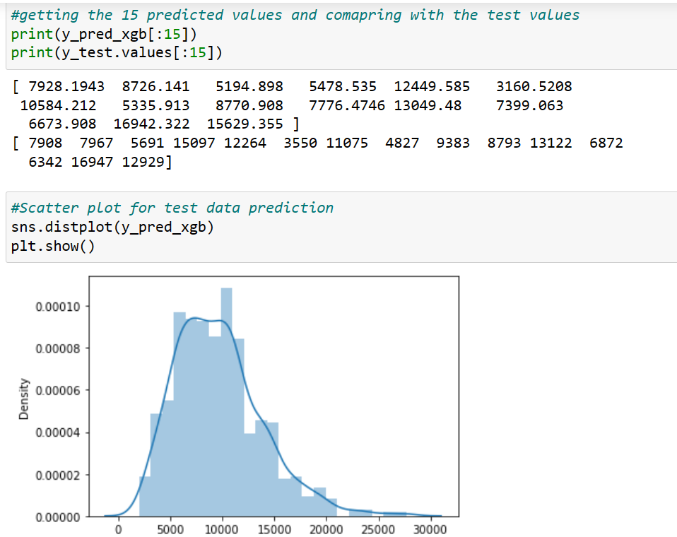
Learning Outcomes of the Study in respect of Data Science

Slide 14
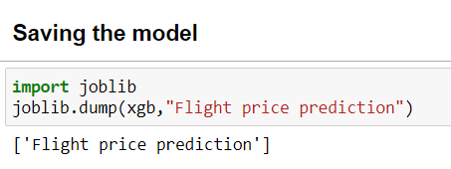
Saving the Model

Slide 15
Limitations and Future Scope
This study shows, it is feasible to predict the airline ticket price based on historical data. One possible way to increase the accuracy can be combining different models after carefully studying their own performance on each individual bin.
Additionally, as the learning curve indicates, adding more features will increase the accuracy of our models. However, limited by the current data source that we have, we are unable to extract more information of a particular flight.
In the future, more features, such as the available seat and whether the departure day is a holiday or not, can be added to the model to improve the performance of the predicting model.
In Future, we need to add extra historical data of flight price which can help to reduce the RMSE error.

